Slide 1




Vehicle fitness test -16
Team Name : Dabhole Nishandar
Team Members:
1 ) Mr. A. S. Dabhole
( Team Leader)
2) Mr. S. V. Nishandar
Assistant Professor , Mechanical Department
ANNASAHEB DANGE COLLEGE OF ENGINERRING & TECHNOLOGY ,
Ashta,(Sangli ,Maharashtra )

Slide 2



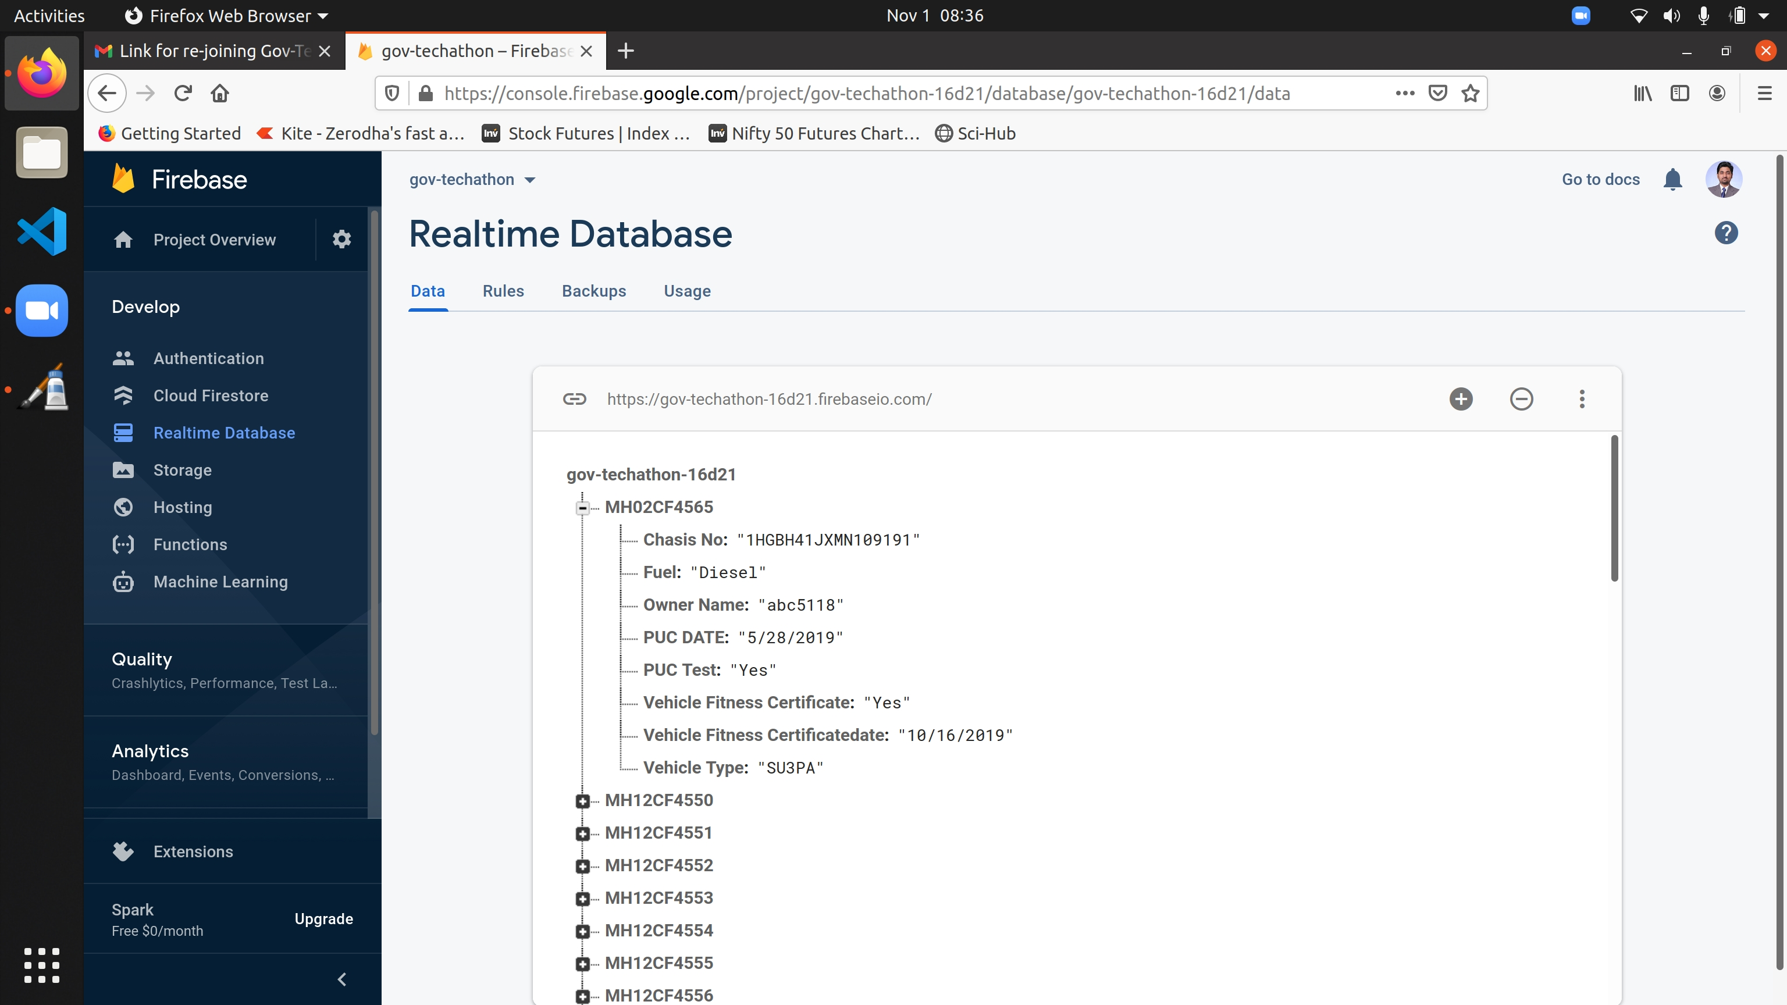
Structure
Get Vehicle Data and upload it to Google Firebase database.
Analysis of Data with Suitable Model in Python
Representation of data with Dash Framework

Slide 3


Step 1
During Assessment we going to take following data
Vehicle Number
PUC Test Values
PUC Certification Validity
Visual Inspection Values
Images Of Vehicle from Different angle
Note –
Once we type vehicle number –under VAHAN Website Rule:62 , we can sort which type of test is carried out

Slide 4
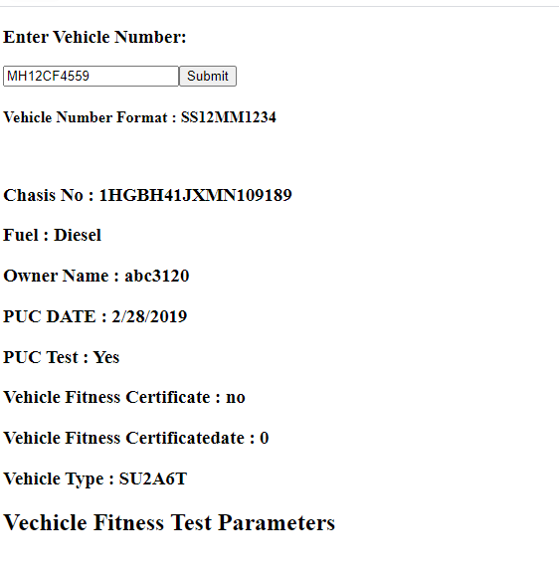
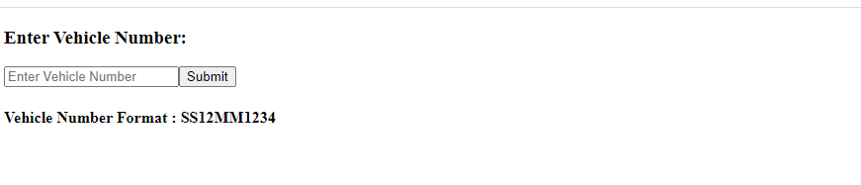
First visit Following Web Link http://dabnish.pythonanywhere.com/
Enter Vehicle number and submit

Slide 5
Step-2
We classified test data in three Categories
2.1) Visual Inspection data (Y/N)
2.2) PUC data(Emission Values)
2.3) Vehicle Images (Upload)
Analysis of Data with Suitable Models
Python will be Used

Slide 6
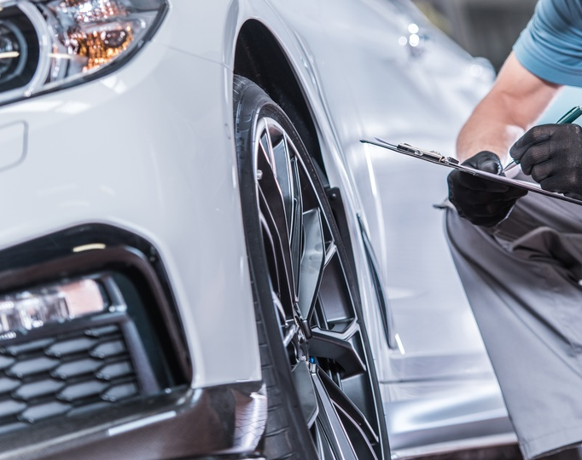
Step -2.1) Visual Inspection data (Y/N)

Slide 7
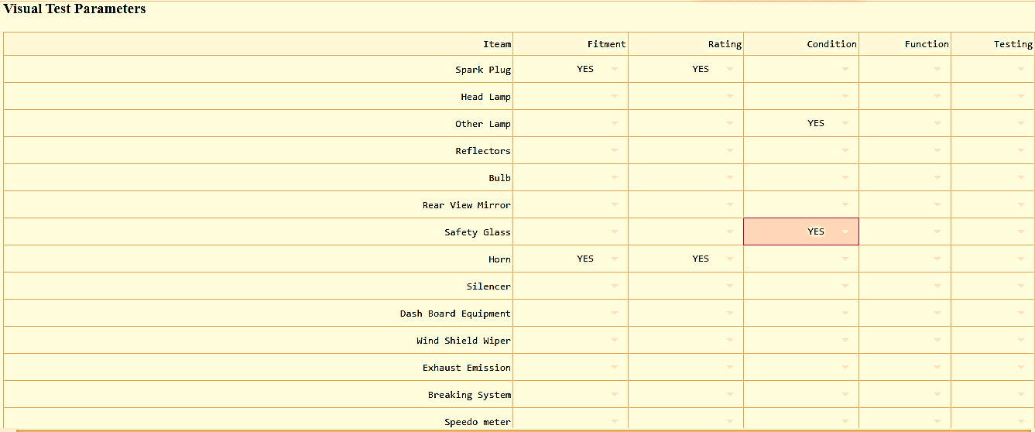
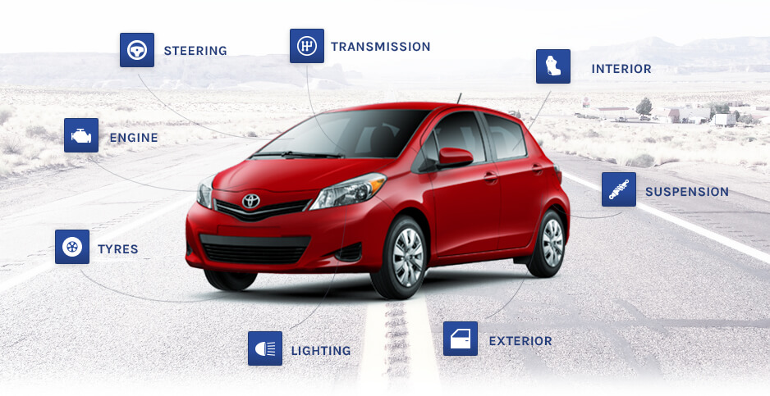
VEHICLE FITNESS SPECIFIC RULES (RULE-62)

Slide 8

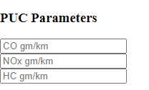
Step -2.2) PUC data(Emission Values)
In this Analysis we going to put values of PUC test like
Nox
Co
HC
And going to validate with Norms and give remark either within range or not
Enter Values

Slide 9
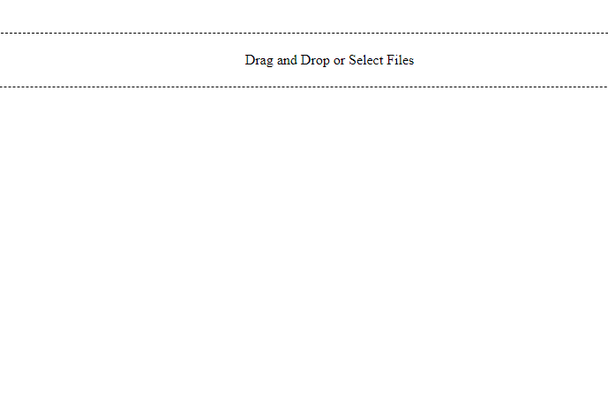
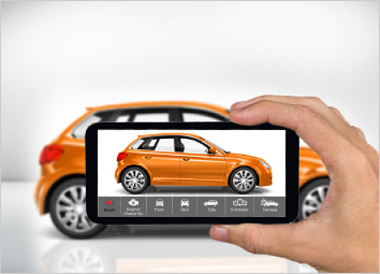
2.3) Vehicle Images (Upload)

Slide 10
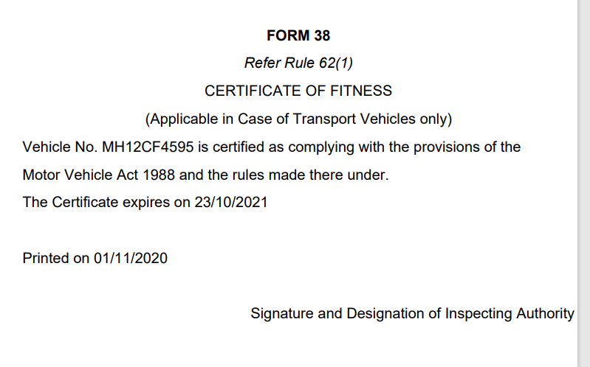

After all three steps click on Submit test data – Will Get Fitness Form 38

Slide 11

Step -3
Representation of Data :
Dash Frame work will be used

Slide 12

Thank you

